Slide 1
Course Introduction
CSCI 3350 - Software Engineering II
Fall 2014
Bill Pine

Slide 2
Lecture Overview
Course web site
Handout and review syllabus
General expectations

Slide 3
Course Web Site
I maintain a web site with links to pages for each course that I teach
faculty.etsu.edu/pine
Each course page contains
Lecture slides
Handouts
Exercises

Slide 4
Course Syllabus Key Items
Office Hours
As posted on Web page and outside office door
I try to always be present during posted hours
I am in my office many additional hours
If the door is open or ajar
Feel free to knock
If the door is closed
I am either not in my office, or
I do not wish to be disturbed

Slide 5
Course Text
Software Engineering Modern Approaches
Braude and Bernstein
ISBN 978-0-471-60208-9
Recommended Reference
UML Distilled
Martin Fowler
ISBN 0-321-19368-7
I do not lecture on all material assigned in text
You are responsible for all material assigned

Slide 6
Grading Criteria
Your final grade will be determined by
Tests
2 Tests – Midterm and Comprehensive Final Exam
~ 25% of the final grade
Major Team Project
~ 31% of the final grade
Homework and Quizzes
~ 13 % of the final grade
Oral presentations
~ 31% of the final grade

Slide 7
Attendance Policy
Attend all classes
Experience shows
Poor attendance ≡ Poor performance
Availability of class lecture slides is no substitute for class attendance
If you are absent, Your responsibility to catch up
The University requires that I take attendance

Slide 8
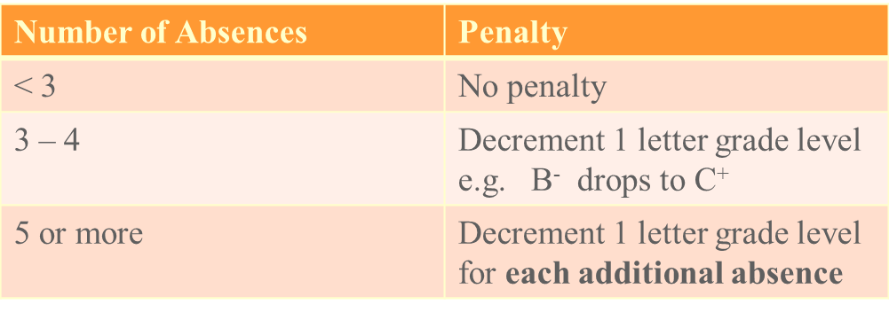
Attendance Policy (cont)
You must attend at least two-thirds of a day’s scheduled class time to be considered present
Repeated lateness or early departures may be counted as an absence at the instructor’s discretion

Slide 9
Tests
Two tests
Midterm at approximately 8 weeks
Second test is the comprehensive course final exam
Missed tests cannot be made up
Without prior approval, or
Without verifiable extenuating circumstances
Make-up test may be oral examinations, at the discretion of the instructor

Slide 10
Quizzes and Homework
No makeup for missed quizzes
No late homework accepted

Slide 11
Academic Dishonesty
The student-teacher relationship is based on trust
Unless specifically stated otherwise, all work must be your own
Your name on the submitted work is an affirmation that the work is entirely your own
When submitting team work, all team members’ names must appear on the work

Slide 12
Academic Dishonesty (continued)
Any student engaging in academic dishonesty, or assisting another student in academic dishonesty
Will receive a grade of F for the course
Academic Dishonesty
Copying another student’s work
Submitting the work of another as your own
Allowing others to copy your work
Every keystroke / mouse click must be your own
Questions or Comments?

Slide 13
General Expectations
I Believe That
Each student is responsible for his own education
Actions have consequences
I Am Always Willing to Help Students Who Seek Help
In Return, I Expect
That you will do all assignments
Read ahead of where I am lecturing

Slide 14
Class Behavior
I Will Accord to You the Respect Due a Fellow Human Being
I Expect the Same From You Toward Me and Your Fellow Classmates
No
Heckling,
Snide remarks, or
Put downs

Slide 15
Class Behavior (continued)
Generally, I Do Not Tolerate
Aside conversations among students
Habitual lateness
Practice Good Manners
“Make Your Momma Proud”
If You Have a Problem With the Way in Which I Run the Class
Come talk to me

Slide 16
Seeking Help
If You Are Having Problems,
Seek help immediately
Don’t wait until you fall hopelessly behind
Course Material Is Cumulative
Drop by My Office, Early in the Semester
Before you are having problem
To locate my office
To overcome your natural reluctance to visit the “ole buzzard’s lair”

Slide 17
Asking Questions
I Encourage Questions
When the question arises
If You Don’t Understand Something
A word
A concept
A calculation
A code snippet
A S K !

Slide 18
Questions or Comments?

